Slide 1
CS2040/C
Week 09, guideline slides only

Slide 2
Admin – PS1-2-3 “issues”
We have a list of suspicious submission cases for those 3 PSes
TAs have compiled these reports for me to decide (soon)
Students with submission(s) that is/are “confirmed beyond reasonable doubt a result of plagiarism” will have his/her associated PS converted to 0
Steven aims to do this “clean-up” *before* PS4 is due
If his/her PS4 and/or PS5 also like that, then his/her entire PS score is 0
Anyway… for those who “get away with” in 2/3-weeks long PSes, we have…

Slide 3
Admin – PE (1)
Practical Exam (15%)
Timing: Wed, 28 Oct 2020, 7.00-9.00pm – 2 weeks from today
Standby for e-proctoring by 6.45pm ish, we aim to start on time
Wed, 28 Oct 2020 10.05am-11.35am lecture is “cancelled”, I replace your time
Those who confirm cannot make it (other modules/commitment etc), get an “official acknowledgement” from Steven first so that you have a slot during make up PE (Study Week)
Latest official email to notify Steven is by Wed, 21 Oct 2020, 09:59am (before next week’s lecture)
You will be flagged as AWOL if you disappear during PE night without such confirmation

Slide 4
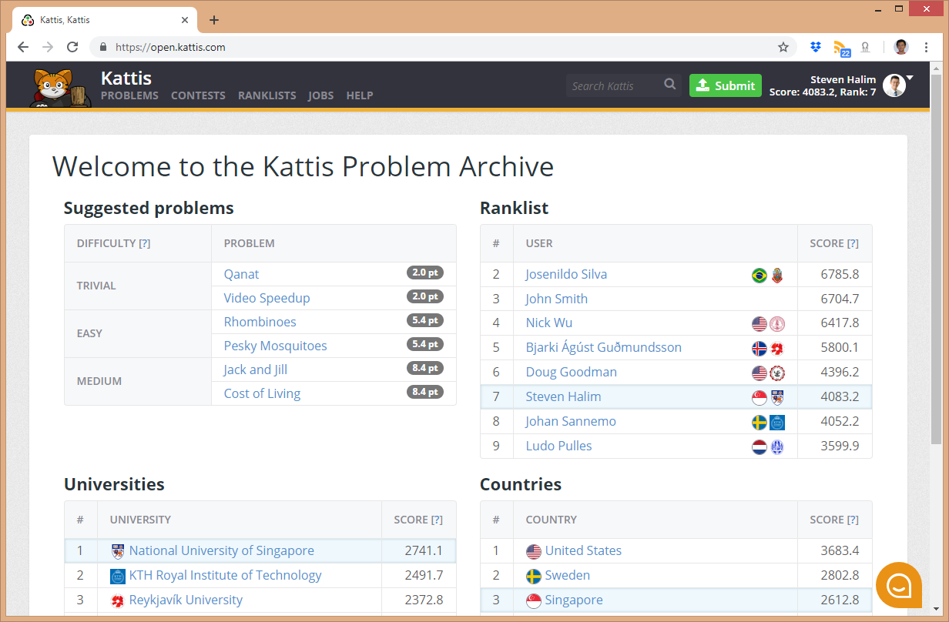
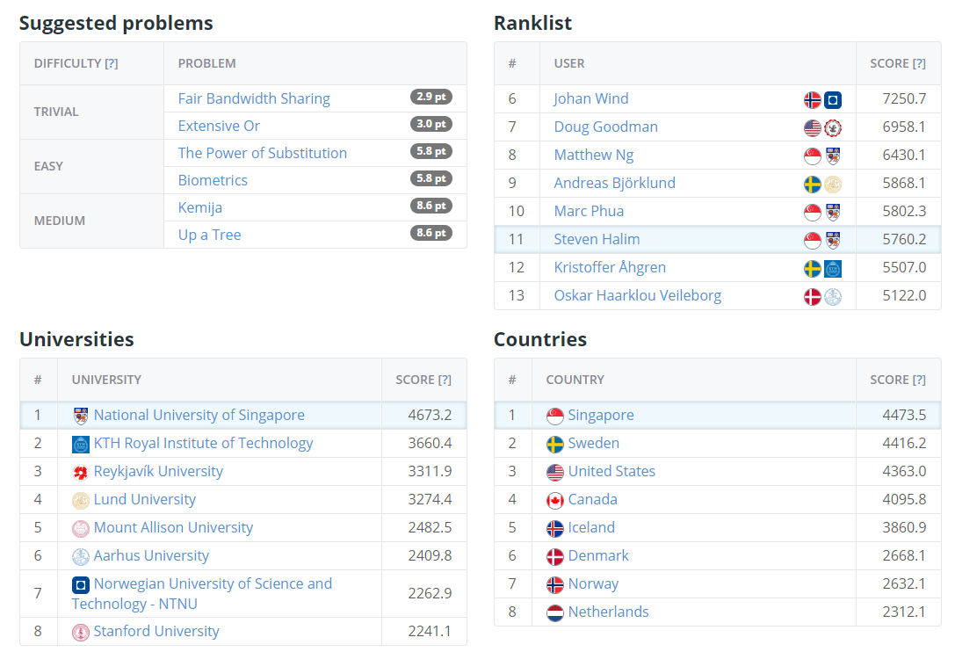
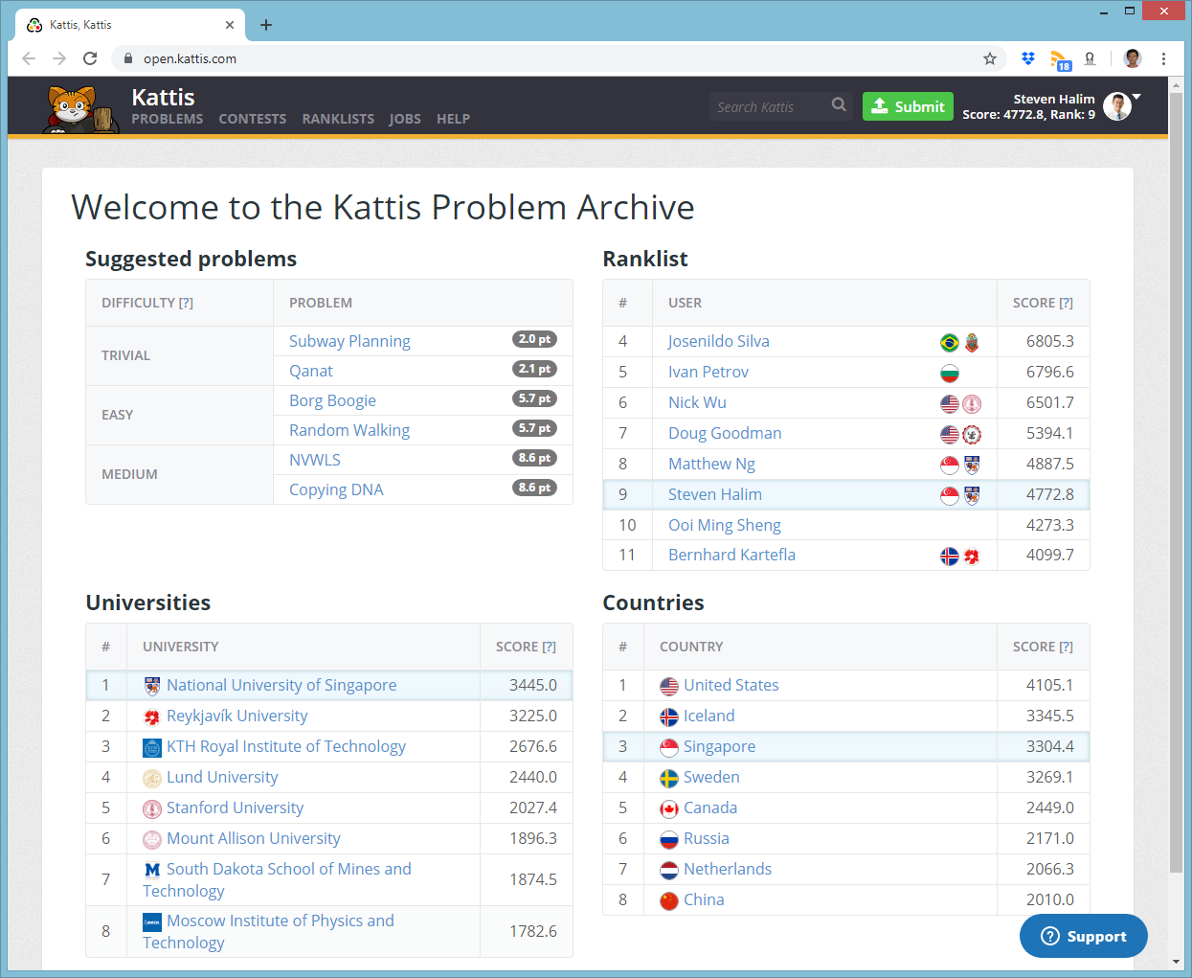
Admin – PE (2)
There will be 2 tasks
Both “projected to be” “easy” level but with “trivial” subtasks @ open.kattis.com later

Slide 5
Admin – PE (3)
Open Internet (read only) with e-proctoring setup as per e-Midterm Quiz
There will be 2 new tasks
Various DSes/Algos to solve these 2 new tasks will have been discussed by Wk 10
But not easy to see all the required components in stressful 2 hours setting
Also not easy to Google (perhaps also impossible, e.g., “unique constraints”)
Always aim to get some easier subtasks if you cannot go for full 100 marks
There will be partial marks grading
Especially for lower scoring ones
Mostly automatic unless you can’t even pass Subtask 1
We will be quite strict on the harder subtasks one
e.g., the ‘proper Radix sort’ vs counting sort vs standard sort for PS1 B

Slide 6
Admin – PE (4)
There will be a Mock PE during Wednesday lecture on Week 10 :O
Ensure that your own PC/Laptop is equipped for this PE battle
e.g., an offline C++ 17 compiler (will be checked by proctor)
Please do not use repl/ideone/any other online editor during PE night; once spotted as plagiarism source, your PE is 0 (no make up)
One important new rule: Compile error is 0 (Kattis doesn’t recognize it/doesn’t appear in scoreboard), so during last minute submission, comment buggy parts that causes compile error… very low partial marks for such a submission (won’t be larger than subtask 1 score)

Slide 7
Final PE Admins Next Week (Week 10)
We are finalizing the details…

Slide 8
Review of Graph Concept
https://visualgo.net/en/graphds?slide=1 to 5
Q&A on the basic stuffs:
Let’s draw random graph (or use random sample graph) and Steven will ask random stuffs about that graph
Exercise: Let’s find some real-life graphs around us
Not really asked:
All terminologies in slide 1 to 1-7, close to 0 question recently
Notes:
Random exercise using https://visualgo.net/en/graphds exploration mode, showcase a few graph problems that we will discuss in CS2040/C (and beyond, just FYI), remind students that graph (structure) and graph drawing are actually two different but related topic, briefly talk about planar graph but say it is for future higher level algorithm modules
Other examples: Module pre-req graph (actually a DAG), Chess/Go game state graph (or piece movement graph), Friendship/study group graph, etc… Try to do this exercise on more routine basis as you navigate through your own life
Spares
Too basic, rely on e-Lecture slides for definition of vertex, V, edges, E, path, cycle, component, etc…

Slide 9
Review of Special Graphs
https://visualgo.net/en/graphds?slide=6 to 6-7
Q&A on special graphs stuffs:
We focus on discussing Tree (now not necessarily Binary) as a subset of Graph
Quick one: Complete Graph and Bipartite Graph
We also discuss Directed Acyclic Graph (directed graph without any cycle)
Not the main focus:
A bunch of other special graphs
Notes:
Trees: This time not necessarily Binary/Complete/Full/Balanced etc; E = V-1, connected, unique path between any pair of vertices; no non-trivial cycle; rooted vs not rooted (yet); more notions of hierarchies; PS: this “Tree” E = V-1 thingy is later revisited in the live demo: /flyingsafely ☺
Complete Graph is far easier to see/understand. Bipartite graph is not frequently used in CS2040/C level in favor for more important/frequent special graphs: Trees and DAGs.
DAGs: Directed, has no cycle (acylic), we can find topological ordering of the vertices in linear time (further discussion soon in DFS/BFS lecture)
Spares:
Star graph, wheel graph, pseudo tree/forest, planar graph, etc

Slide 10
Review of Graph Data Structures
https://visualgo.net/en/graphds?slide=7 to 7-11
Q&A on graphds stuffs:
We start by reviewing Adjacency Matrix first and its 2D array storage and its required (bloated) space complexity
Then we show Adjacency List, which can be treated as a “compressed form of Adjacency Matrix” and its vector of vector of integer pairs storage; This is our default graph data structure for most CS2040/C graph related problems…
Finally, we discuss Edge List, both AL and EL implementation are made much easier in C++17 (using structured bindings)
Discussion of strengths and weaknesses: Focus on AM vs AL first, more in Tut 08
Not asked:
Conversion of one graph DS to another, in Tut 08
Notes:
AM: O(V^2) space complexity, the one that makes it least popular graph data structure,
AL: O(V+E) space complexity. PS: You can view this similar as “Separate Chaining” strategy of Hash Table :O, show the comparison
EL is not frequently used in CS2040/C now due to MST topic shelved for CS3230, but it can be useful for applications involving sorting the edges based on certain criteria; we digress a bit about C++17 structured binding feature that makes things much simpler than before (but cannot be used for PE yet)
AM: clearly not good for sparse graph (or embedded system stuffs/relevant for CEG people); AL: slightly slower for checking existence or weight of edge (u, v) but good at enumerating list of neighbors of a given vertex; More details during Tut 08
Spares:
Discussed in Tut 08 later, especially if we are given input in one type and need to perform operations that are better done using another graph data structure

Slide 11
Review of Simple Graph DS Applications
https://visualgo.net/en/graphds?slide=8 to 8-10
Q&A on application stuffs:
Enumerating neighbors of a vertex u
Checking (or modifying) the existence (or weight) of edge (u, v)
Not asked:
Counting V and E (those two are trivial)
What is the best Graph DS then?
To be discussed in the future: Transposing a graph, Complementing a graph
Notes:
The one most frequent graph algorithm operations, best supported via Adjacency List DS, O(k), k is the number of neighbors of a that vertex
Another possible graph algorithm operation, best supported via Adjacency Matrix DS, O(1) for such check/update
Spares:
V+E are trival;
Well, this is a University level course, more likely the answer is “It depends”… on the given context… which we shall discuss in more details in tutorials/labs
These are two other common operations that we may need to do involving graph ds: Transpose: Only meaningful on a directed graph. Transposing a directed graph means reversing the edge directions of the original graph. It may be useful for some applications that you will see later :O… Complement: Maybe useful in some scenario (Independent Set vs Clique)
Notes: EL is not frequently used in CS2040/C due to MST topic shelved for CS3230 (EL is good for sorting edges based on certain, usually weight, criteria)

Slide 12
Live Demo
https://nus.kattis.com/problems/flyingsafely
A trivial (very easy) problem if you understand everything so far…
Solution:
See flyingsafely.cpp/java/py and the detailed comments there and be surprised
Problem Description in PE will be much more concise
And we will write CS2040/C specific hints too :O
Also see all these nice implementation of 3 graph DS that we discussed today at: https://github.com/stevenhalim/cpbook-code/blob/master/ch2/graph_ds.cpp
Notice heavy C++17 usage there

Slide 13

Next e-Lecture for our Flipped Classroom
When we resume tomorrow, please self-read the first few slides of https://visualgo.net/en/dfsbfs?slide=1 (until slide 5-8)
We will generally skip slides 8-12 (outside CS2040/C syllabus)
Time permitting: We do a preview first before tomorrow ☺

Slide 14
Plagiarism Report Updates
PS1 (Due 05 September 2020 :O), focusing on 179 and 200 pointers
3 students (A/B/C), A “copy” B and A “copy” C caught beyond reasonable doubt
3 other students (D/E/F) have very suspicious PS1 B code fragments (especially certain parts in Radix Sort implementation)
These triples are “currently let go” but will be closely monitored in PS4-5+PE
PS2 (Due 19 September 2020 :O)
2 students (the same A/B) from above, again :O
We are suspicious with 2 other pairs (G-H and I-J) but not clear black and white (our Spider sense is triggered); accusing them will likely cause back and forth arguing so… we let them go and will monitor (and compare) their PE results
PS3 (Due 10 October 2020)
Still being processed, not 100% clean probably

Slide 15
PE Confirmed Absentees (Approved) Will do Make up PE (Week 13/Study Week)
Lee Yan Peng (has IS3103 class every Wednesday night, double confirmed with NUSMods)
Ryan Kwok (has USP class every Wednesday night, double confirmed by the affected USP lecturer herself)
Anyone else?

Slide 16
Review of Graph Traversal on Tree
https://visualgo.net/en/dfsbfs?slide=1 to 4
Q&A on Graph Traversal:
Let’s do a recap of traversal on tree and what was always NOT present in a (rooted and directed-downwards) tree but can exist in a general graph...
Revision of various tree traversal routines on binary tree? Try this mini pop quiz
Notes:
This is the link to connect previous ideas that you already know (some way to traverse/navigate a binary tree) vs a more general way to navigate a general graph that may contain more branching options and most importantly: encounter cycle condition
Review inorder traversal of BST etc

Slide 17
Review of DFS/BFS Algorithm (basic form)
https://visualgo.net/en/dfsbfs?slide=5 to 6-4
Q&A on DFS/BFS:
We will do a live (visual) demonstration of running DFS and BFS algorithm on random small graph and re-analyze on why both run in O(V+E)
After sufficient exploration, we will compare the features of DFS vs BFS
Not asked (yet):
The DFS analogy and the BFS analogy
Notes:
The details are in e-Lecture slides, this is just a recap. A live (code) demonstration will be done later during Lab Demo 07
DFS: Depth First, BFS: Breadth First, both will visits the same set of vertices if started from the same source vertex, just possibly in different order. These two visitation strategies give rise to different applications that we will discuss in more details next time (DFS for counting CC, detecting cycle, finding toposort of a DAG; BFS for finding SSSP on unweighted graph).
Spares:
The analogies are only to help you understand the algorithm

Slide 18
Live Demo
https://nus.kattis.com/problems/reachableroads
A very easy problem if you understand basic DFS/BFS so far…
Solution:
See reachableroads.cpp/java and the detailed comments there
Also see all these nice implementation that we discussed today at: https://github.com/stevenhalim/cpbook-code/blob/master/ch4/traversal/dfs_cc.cpp (with example of finding/counting number of CC, similar to demo /reachableroads) and https://github.com/stevenhalim/cpbook-code/blob/master/ch4/sssp/bfs.cpp (integrated with a few other things like finding SSSP on unweighted graph)

Slide 19
Next e-Lecture for our Flipped Classroom
Next week (one week before PE), we will resume on the harder part of graph traversal slides 7 to 7-11, the applications of DFS/BFS: not just simply traversing a graph
We will generally skip slides 8-12 (outside CS2040/C syllabus)
There will be a few live demo that day, so please revise all these /graphds and /dfsbfs e-Lectures before attending
/graphds (more likely) and /dfsbfs (less likely) *may* appear in PE
/sssp (even unweighted graph) will not appear in PE (yet), but may appear in make up PE

